Slide 1
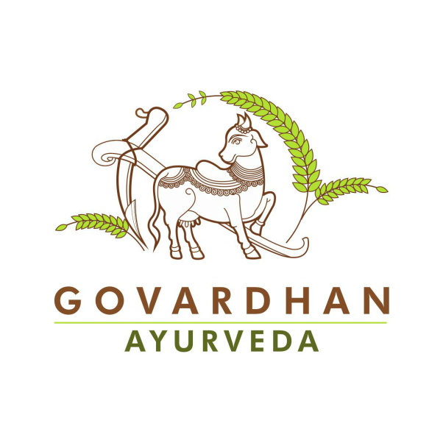
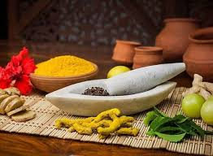
AROGYAM RECIPES
Dr. Rajashree Deshmukh
(bhaktishakti dd)
Ayurveda consultant
Govardhan Ayurveda
GEV
Phone no. 9763338092
Email- rajashreekdeshmukh@gmail.com

Slide 2
SESSION 1
POINTED GOURD SUBJI
RADDISH LEAF CHAPATI
KOKUM CHUTNEY
GOLDEN BUTTERMILK

Slide 3

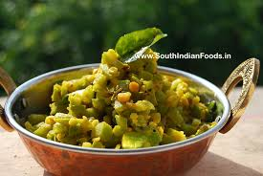
POINETD GOURD SUBJI
INGREDIENTS
1.pointed gourd 2-3 –cut in small pieces
2.mung daal- 5 table spoons
3.mustard seeds-1 tea spoon
4.cumin seeds- 1 tea spoon
5.asafoetida- 1 pinch
6.turmeric- 1 tea spoon
7.Red chilli powder- half tea spoon/grated ginger- half to 1 tea spoon
8.rock salt (saindhav)- as per taste
9.Cow ghee- 1 table spoon
10. coriander and grated coconut for garnishing

Slide 4
PROCEDURE
Take one iron pan, switch on gas add cow ghee, add mustard seeds, let it crackle, switch of gas, then add cumin seeds, asafoetida, turmeric and subji +daal, mix all ingerdients then add chilly powder , mix well and then add some water
Cover it with lid
Cook on low flame
Check after 5 min then add saindhav salt and add little water if required again cook for few minutes
Transfer all ingredients in serving bowl and garnish it with coriander and grated coconut
Offer to lord with tulsi leaf.

Slide 5
benefits
Balances all dosha
Nourishing
Advised in all kind of diseases
Healthy subji
Good in diabetes, gastric issues
Immunity booster

Slide 6
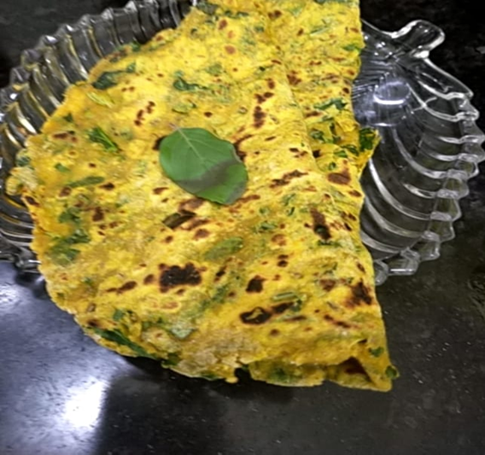
RADISH CHAPATI
Ingredients
Cut leaves of radish-1 bowl
Wheat floor-1 bowl
Turmeric- 1 tea spoon
Cumin seeds- 1tea spoon
Rock salt-as per taste
Water- 1 glass
Oil/cow ghee- 1 tea spoon

Slide 7
Procedure
Mix all ingredients except oil
Make a soft dough
Then add oil and keep the dough for rest
Then roll chapatti and roast it on iron griddle.
Offer to lord with Tulsi leaf

Slide 8
Benefits
Good for those who have recurrent kidney stone issues
Good source of fibre so helps in constipation
Helps in recurrent cold, cough and asthma
Helps in obesity, high cholesterol etc.
Good for children

Slide 9
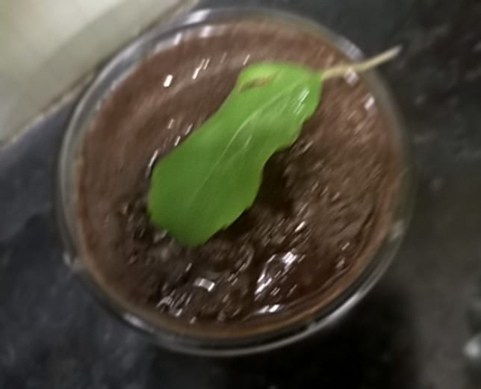
KOKUM CHUTNEY
INGREDIENTS
Soaked kokum- 4- 5
Grated coconut -2 table spoons
Cumin seeds- 1 tea spoon
Jaggery- 1 -2 tea spoon
Saindhav (rock salt)- 1 tea spoon (as per taste)

Slide 10
Procedure
Grind all ingerdients in a chutney jar
offer with tulsi leaf

Slide 11
Benefits
Kokum is pitta pacifying so helps in heart burn, heat in body
Coconut is soothing to digestive system
Best pitta vata shaman (pacifying)
Good for gastric, duodenal ulcers and burning acidity issues
Aids digestion
Helps in absorption of nutrients from gut.

Slide 12
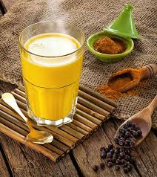
Golden buttermilk
Ingredients
Homemade Curd 2 tea spoons
Water 100- 150 ml
Cow ghee- 1 tea spoon
Cumin seeds- 1 tea spoon
Fenugreek seeds- half tea spoon
Grated ginger- 1 tea spoon
Asafoetida- 1 pinch
Turmeric- half tea spoon
Curry leaves- cut or paste
Himalayan pink salt- as per taste
Jaggery- 1 tea spoon

Slide 13
Procedure
Take a pot, add a tea spoon of cow ghee
Keep gas on low flame
Add cumin seeds, fenugreek sees, asafoetida, turmeric, ginger, curry leaves and water
Add himalayan pink salt and little jaggery
boil and serve hot

Slide 14
benefits
Good for digestion
Good in piles, IBS, digestive issues
helps to reduce swelling
Improves immunity
Aids weight loss

Slide 15
Session 2
Bajra (pearl millet )khichadi
Raw turmeric pickle
Flax seeds chutney

Slide 16
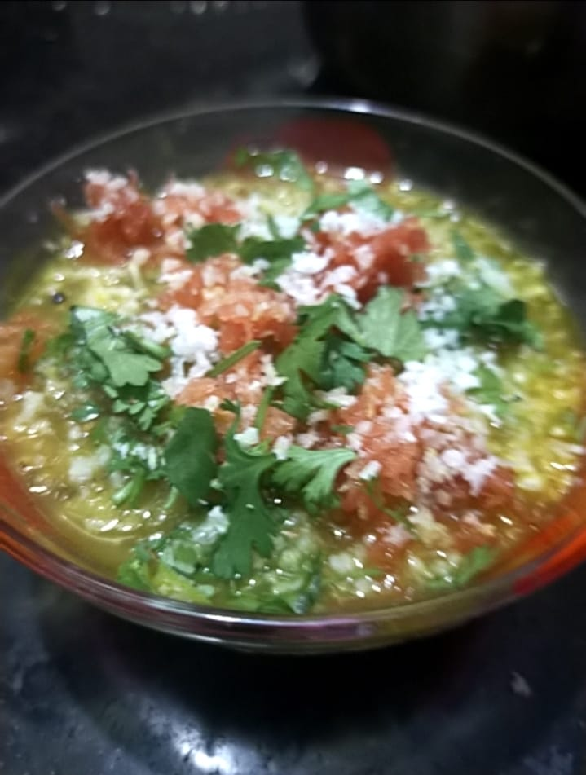
Bajra (pearl millet )khichadi
Ingredients
Bajra (pearl millet) – 1 bowl (soaked overnight)
Mung dal (yellow lentil)- 1/4th bowl
Tur dal- 1/4th bowl
Cow ghee- 1 table spoon
Black pepper-2
Cloves-2-3
Cinnamon stick- 1 cm
Fenugreek seeds- 5-6
Bay leaf- 1-2
Mustard seeds- 1 tea spoon

Slide 17
ingredients
Cumin seeds- 1 tea spoon
Asafoetida – 1 pinch
Turmeric – 1 tea spoon
Red chilly powder- half spoon (optional)
Ginger- grated 1 tea spoon
Water 300 ml
Rock salt – as per taste
Grated coconut, coriander, grated carrot – for garnishing

Slide 18
Procedure
First dry roast pepper, cinnamon, cloves and fenugreek seed
Grind all in grinder
Then take pressure cooker
Add cow ghee, add roasted spices and mustard seeds, cumin seeds, asafoetida and turmeric
Curry leaves can also be added
Then add Grated ginger and soaked bajra, mung daal and tur dal
Add salt and water and pressure cook for 3 whistles
Add good amount of water so that it becomes semisolid consistency

Slide 19
Benefits
Bajra has magnesium which is good for brain and heart
It has potassium which dilates blood vessels so helps to reduce blood pressure
It has insoluble fibre which helps in digestion and constipation
It releases slow sugar so good for diabetic patients
Helps in weight loss
No cholesterol- so good for LDA, high cholesterol issues

Slide 20
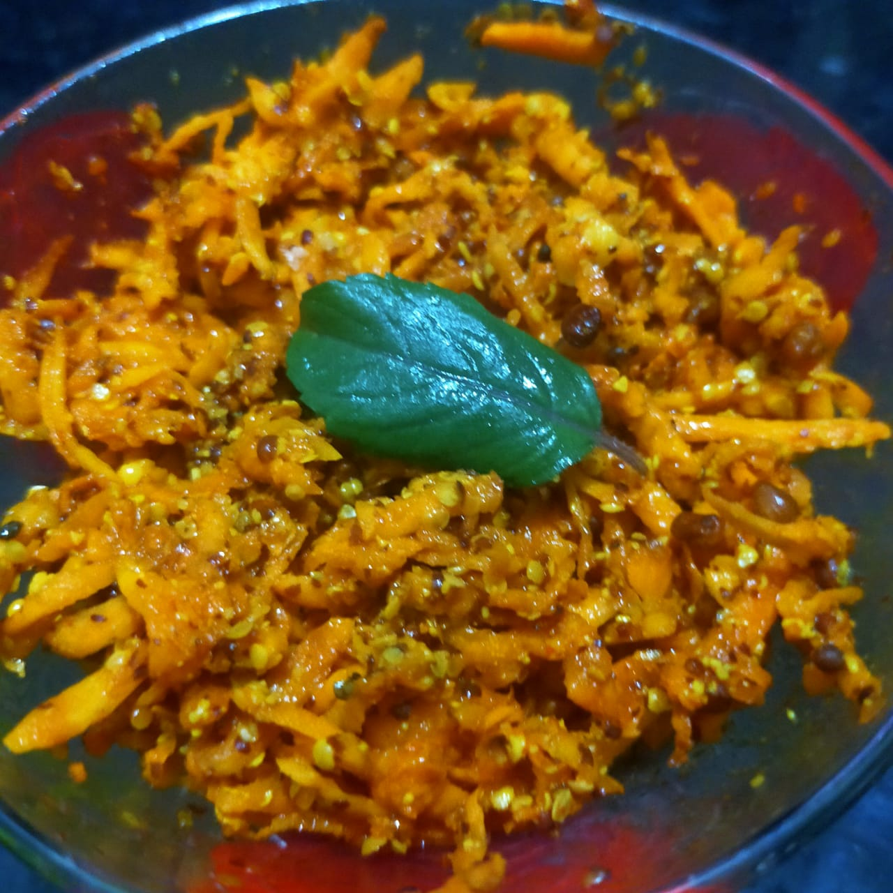
RAW TURMERIC PICKLE
INGREDIENTS
Raw turmeric- grated – half bowl
Cooking oil- 1 table spoon
Asafoetida- 1 -2 tea spoon
Mustard seed – coarsely made
powdered form- 1-2 table spoon
Red chilly powder- 1tea spoon
Salt- 1 -2 tea spoon
Lemon juice- 1 lemon
Fenugreek seeds- 1 tea spoon

Slide 21
procedure
Take oil in one small iron pan, heat the oil add fenugreek seeds to it then take another bowl add coarse mustard seed powder, chilly powder and salt to it and pour the oil in this mixture
mix well everything
Then add this mixture to grated turmeric
Add lemon juice and mix well
It remains outside for one day after that refrigerate it
Consume within a week
Prepare fresh every week.

Slide 22
Benefits
Turmeric is anti –inflammatory
Good for diabetic patients
Fastens wound healing
Good for improving quality of blood( blood purifier)
Improves immunity
Anti- oxidant
Good for inflamed joints

Slide 23
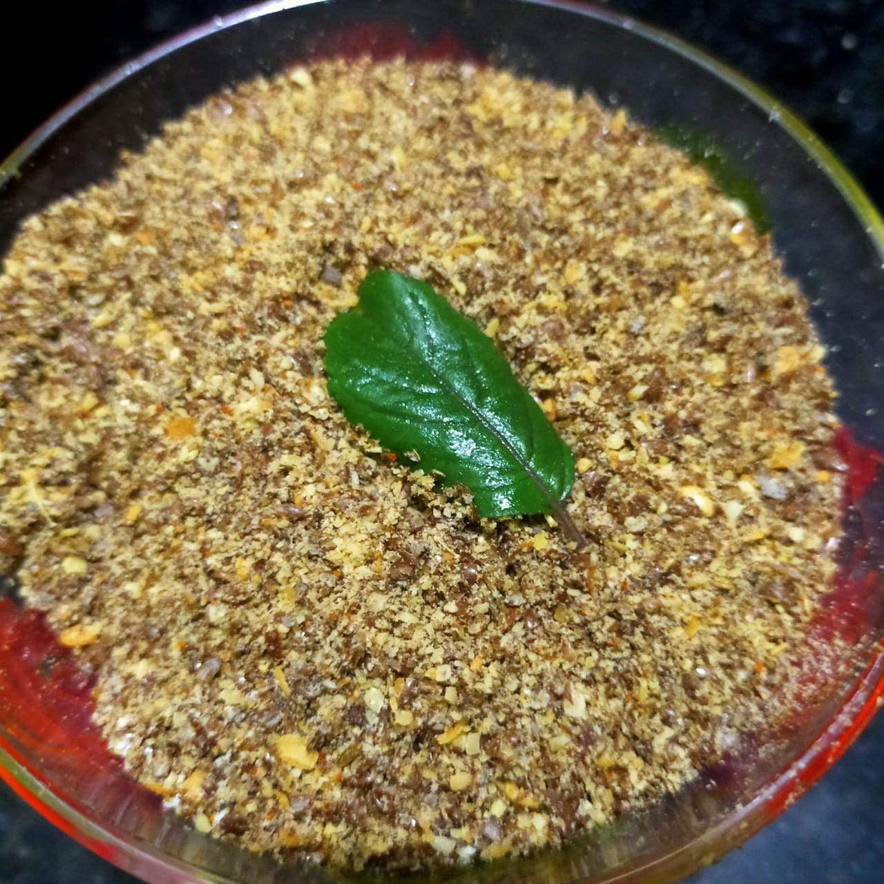
Flax seed chutney
Ingredients
Flax seeds- 1 bowl
Cumin seeds- 1 tea spoon
Red chilly powder- 1 tea spoon
Rock salt- 1 -2 tea spoon

Slide 24
Procedure
Dry roast flax seeds
Then transfer it to grinding jar, let it get cool down
Add cumin seeds, red chilly powder and rock salt
And grind all
Sprinkle on daal rice, salads, subji etc.
Can be consumed 1-2 tea spoons per day.

Slide 25
Benefits
Rich source of omega -3 fatty acids- good for brain and heart
Oil in flax seeds helps to reduce inflammation in joints
Good for hair
Helps to relieve constipation
Anti cancer
Helps in weight loss

Slide 26


